Slide 1


TEAM - HACK BOYS
Abhishek Kumar
Divyanshu Krishna
Satyam Jadon
Arshad Saifi

Slide 2

Uniform Marking Scheme: Leveling the Playing Field
Addressing the disparities in academic grading standards across India, our Uniform Marking Scheme Module aims to create a fair and transparent recruitment process for government positions. By standardizing the evaluation criteria, this innovative solution ensures deserving candidates are selected based on their true potential.

Slide 3
Standardized Evaluation Criteria
1
Consistent Marking Scheme
2
Seamless Grade Conversion
3
Transparent Process
A standardized marking scheme ensures fairness in evaluating academic performance across state boards.
Robust guidelines convert grades and marks from diverse boards into a unified format for fair comparison.
Detailed information on grading criteria empowers candidates to understand the assessment process.

Slide 4
Equitable Selection Algorithms
Balanced Criteria
Regional Adjustments
Continuous Improvement
Selection considers both standardized academic performance and other relevant factors like skills and aptitude.
Contextual factors account for varied educational infrastructure and socio-economic conditions across regions.
Feedback-driven refinements ensure the module remains effective and inclusive over time.

Slide 5

Collaborative Implementation
1
Consensus Building
Collaboration with educational authorities to develop a consensus on standardized marking schemes.
2
Training and Awareness
Upskilling recruiters and informing candidates to ensure smooth adoption of the new system.

Slide 6
Pilot Testing and Evaluation
Pilot Phase
Gathering Feedback
Iterative Improvement
Conducting trials in selected regions to assess the module's effectiveness and identify potential challenges.
Soliciting input from stakeholders to refine the module and address any implementation hurdles.
Incorporating learnings from the pilot to enhance the module before nationwide rollout.

Slide 7
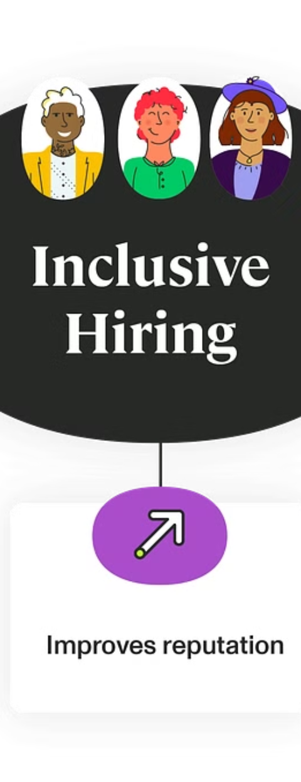



Driving Positive Change
Fairness
Promoting fairness and transparency in the recruitment process.
Opportunity
Empowering deserving candidates from diverse backgrounds.
Societal Impact
Driving positive societal change through equitable access to government positions.

Slide 8


